Slide 1


Prototyping Physical Design
6.4
Preparation
Sketch, Iterate, and Explore
Prepared and presented by: 201806100110051
201806100110052
201806100110057
201806100110083

Slide 2
What is Prototyping?
A prototype is in no way the ready-to-market product, it is just a trial version that is deployed end-to-end with sensors connected through the device, network, cloud, end-user interface, and enterprise integration. Hence, a prototype is a way to visualize your product the way you want it to work and is a proof of concept of what your final product is going to look and work like.
What is Physical Design Prototyping?
Physical Prototyping is the process of making a physical representation of an idea. Early in the process, physical prototypes can be made of all kinds of materials. Physical prototypes allow the designer and users to interact with the idea

Slide 3






Points to Be Discussed
Preparation
Sketch, Iterate, Explore
Tertiary Characters

Slide 4
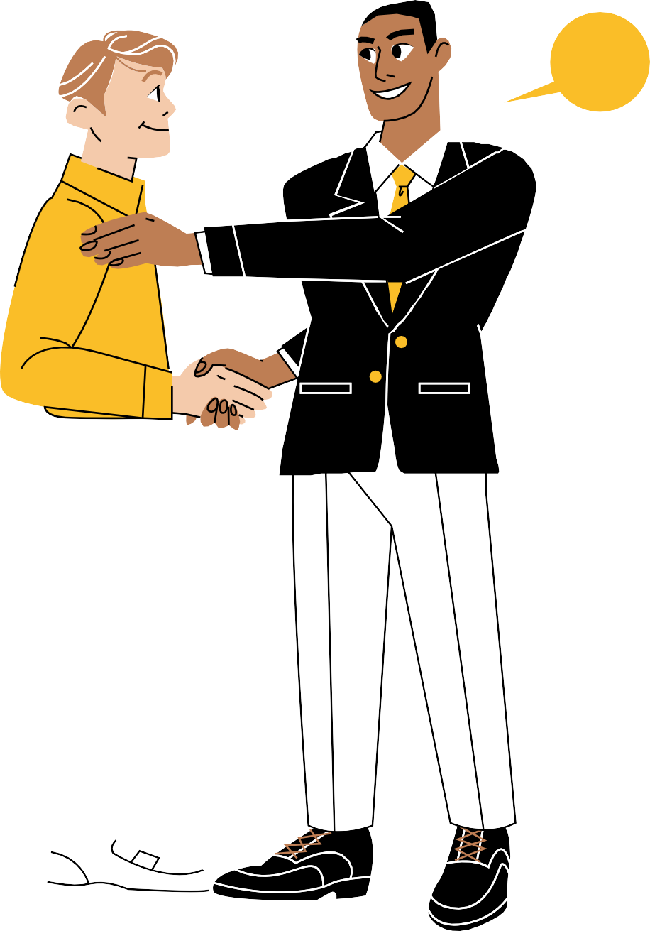
Preparation:
Preparation includes preparing for what design you want which consists of:
How it will look like
Which components to be used
How all these will be executed
For all these first you need to develop an interest in design, over time you will start to work out to a quality you will appreciate
For proper preparation, you need to also think about yourself but also only this is not enough.
you need to get references for a similar type of products to get more idea about:
1)How will be the design
2)How it can be made better
3) How people will like the design

Slide 5
Preparation:
Start looking for different options and don’t stick to one.
Try to Explore more about design
Discuss with people and get their feedback
Finally, over time, you will get ideas to note down and work accordingly,
for further designing.

Slide 6
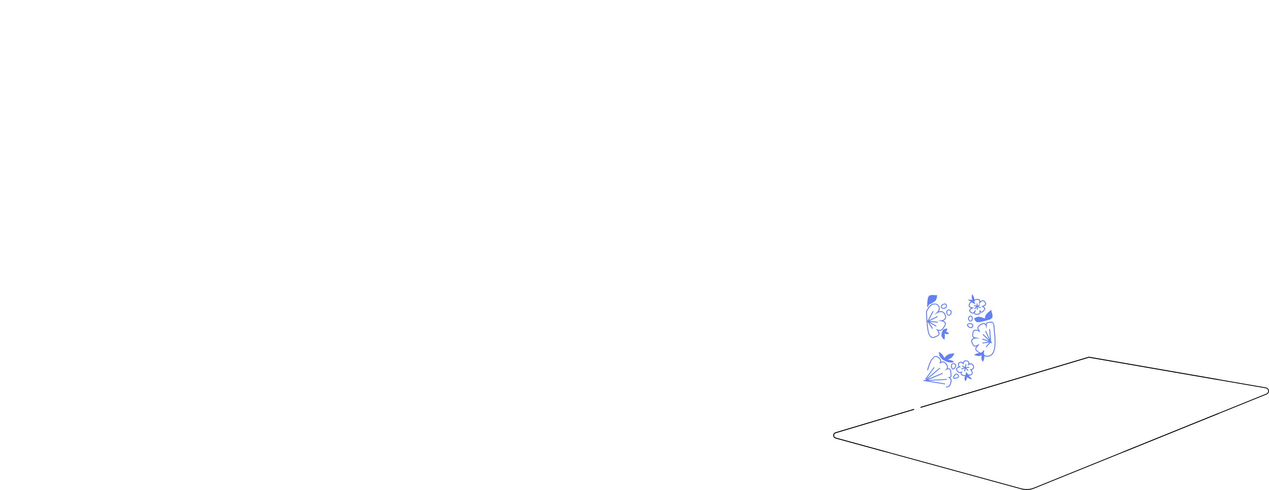
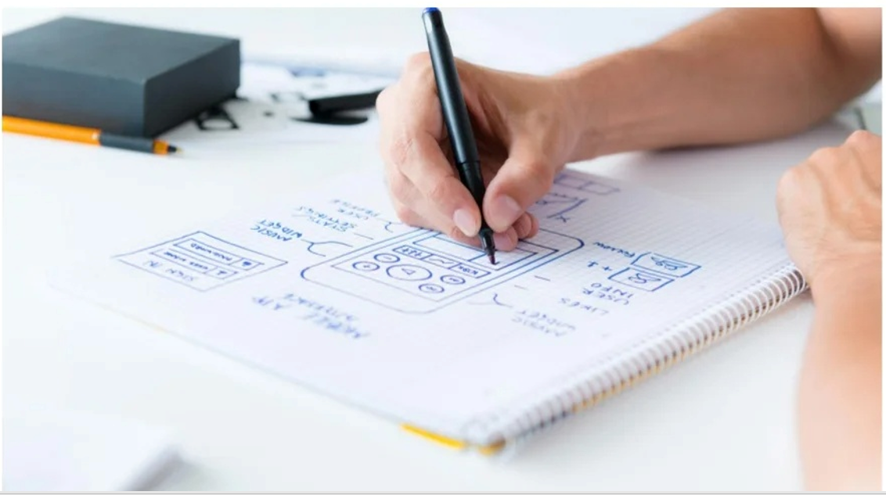

Sketch, Iterate, Explore
Explore Ideas with pen and paper

Slide 7
Sketch, Iterate, Explore
Sketch:
Sketching and repeating the iterative process helps you move through the design funnel,
getting your ideas and design solutions from low to high fidelity and allowing you to tailor
the design to the communication message or digital product
One of the basic things to get ideas in a place is to
sketch it, generally, we write it down but it is
suggested that sketching helps more

Slide 8

Sketch, Iterate, Explore
Sketching helps to identify our design like:
How UI will be designed
What colors will be used
Use tools to design:
1) Solid works
2) Auto-cad

Slide 9
Sketch, Iterate, Explore
Iterate:
Iterating is creating sketches repeatedly to make changes,
as you will not get satisfactory results from just one try.
Try and change designs until you reach the option
you believe is best.
Try different dimension sizes to see how it
affect the design

Slide 10
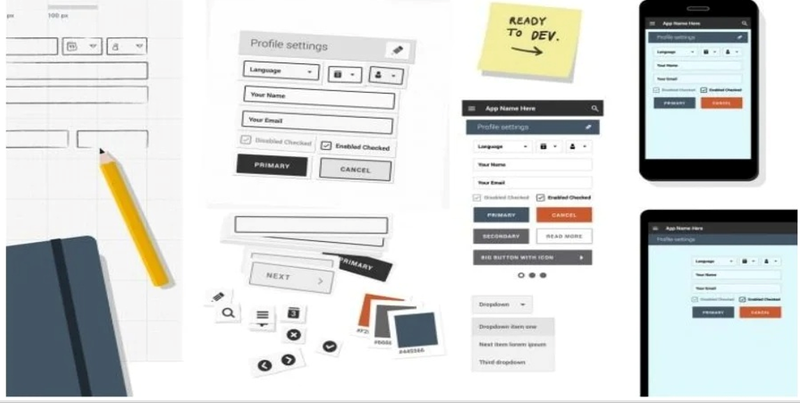

Sketch, Iterate, Explore

Slide 11

Sketch, Iterate, Explore
Explore:
Once you are clear about your design explore different ideas
similar to your idea.
Find other such options from the internet,
youtube videos, magazines ultimately if you have
studied more your product will be more effective
and acceptable to people.

Slide 12
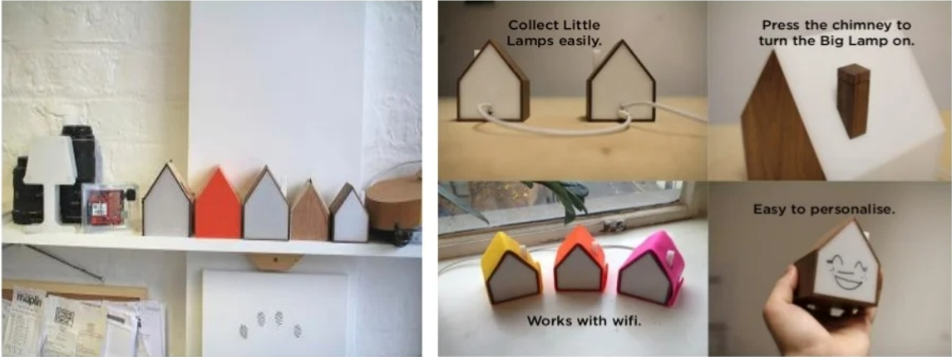
Example:
Night Lamp:
The key lesson is to use these techniques to experiment with different possibilities and learn which features of designs are best. This approach allows you to synthesize the results into a coherent
final design

Slide 13
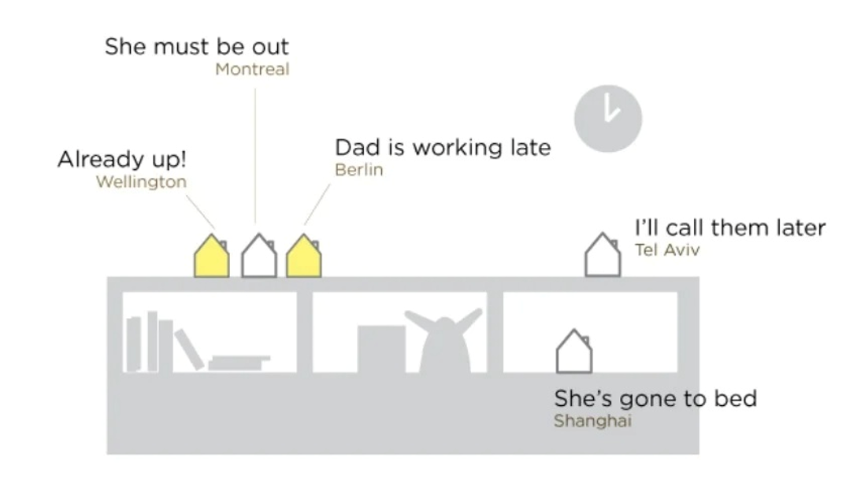
Example:
Night Lamp:

Slide 14
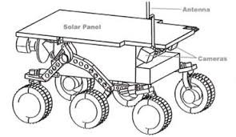
Example:
Spy-Robot:

Slide 15
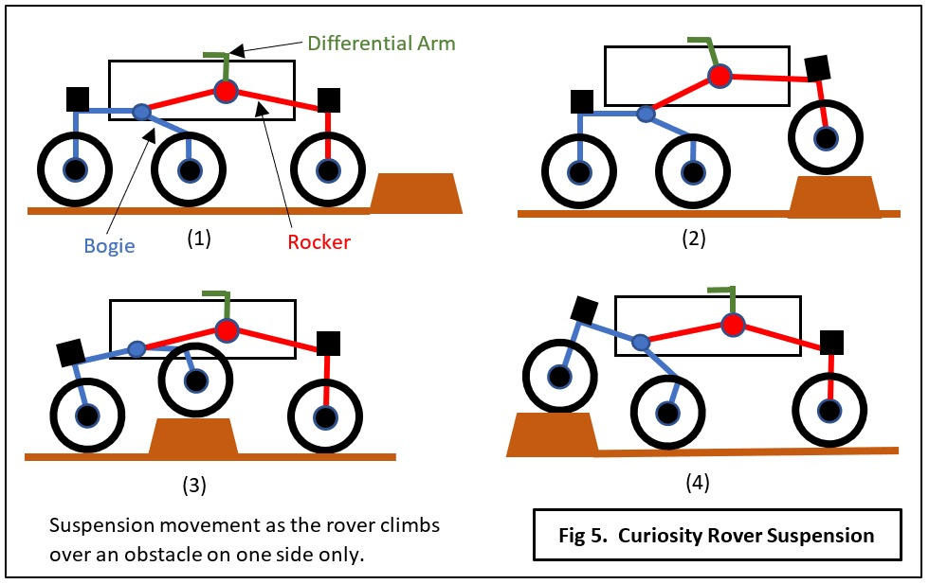
Example:
Spy-Robot:

Slide 16
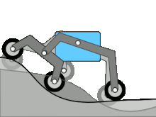

Example:
Spy-Robot:

Slide 17
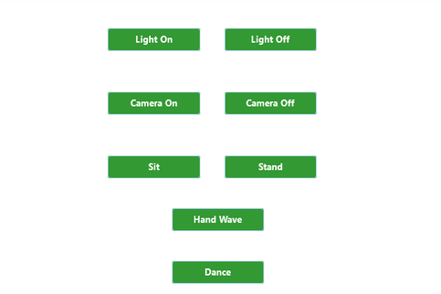
Example:
Spy-Robot:

Slide 18

Thank you!

